Slide 1

Macro preprocessor implementation
Kumar Gaurav - 1DS18CS170
Mudimela Vikas Reddy - 1DS18CS171
Nikhil Raj - 1DS18CS172
Nikita - 1DS18CS173

Slide 2

Introduction
The main motive is implement a macro preprocessor that enables you to define and to use macros in assembly programs.
A preprocessor is a program that processes its input data to produce output that is used as input to another program.
A macro is a fragment of code which has been given a name. Whenever the name is used, it is replaced by the contents of the macro.
A macro preprocessor is a program that copies stream of text from one place to another, making a systematic set of replacements as it does so.

Slide 3

What is Macros?
A macro (which stands for "macroinstruction") is used to make certain tasks less repetitive by representing a complicated sequence of commands or statements into a shorthand notation. It is a fragment of code that has been given a name. Whenever the name is used, it is replaced by the contents of the macro. Macro is defined by #define directive.
There are two kinds of macros. They differ mostly in what they look like when they are used, they are:
1.Object-like macros resemble data objects when used. It is an identifier that is replaced by value. It is widely used to represent numeric constants. For example:
#define PI 3.14
Here, PI is the macro name which will be replaced by the value 3.14.
2. function-like macros resemble function calls. For example:
#define MIN(a,b) ((a)<(b)?(a):(b))
Here, MIN is the macro name.

Slide 4
Macro Preprocessor
A preprocessor is just a tool that allows us to use macros in a program and instructs the compiler to do the required pre-processing before the actual compilation.
It replaces each macro invocation (call) with the corresponding sequence of statements (expansion).
transforms your program before it is compiled. These transformations can be the inclusion of header file, macro expansions etc.
There are two main operations of a macro preprocessor:
1. macro definition
2. macro expansion

Slide 5
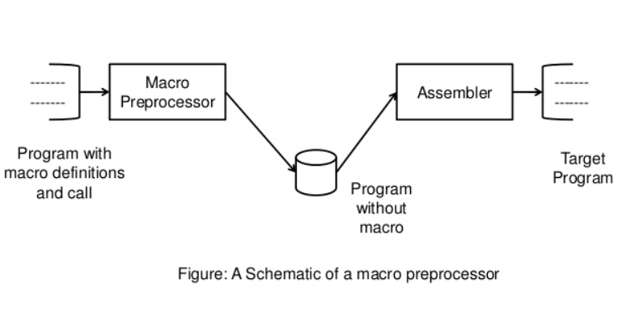
Design of a macro preprocessor
The macro preprocessor accepts an assembly program containing definitions and calls and translates it into an assembly program that does not contain any macro definitions and calls.
The program form output by the macro preprocessor can be handed over to an assembler to obtain the target program

Slide 6
Advantages of using a Macro
Application programs are less likely to contain logic errors.
Errors are more easily found.
Higher productivity during application program development.
Improved application program design.
Application programs are more easily maintained.
Application programs are easier to read and understand.

Slide 7


